Slide 1
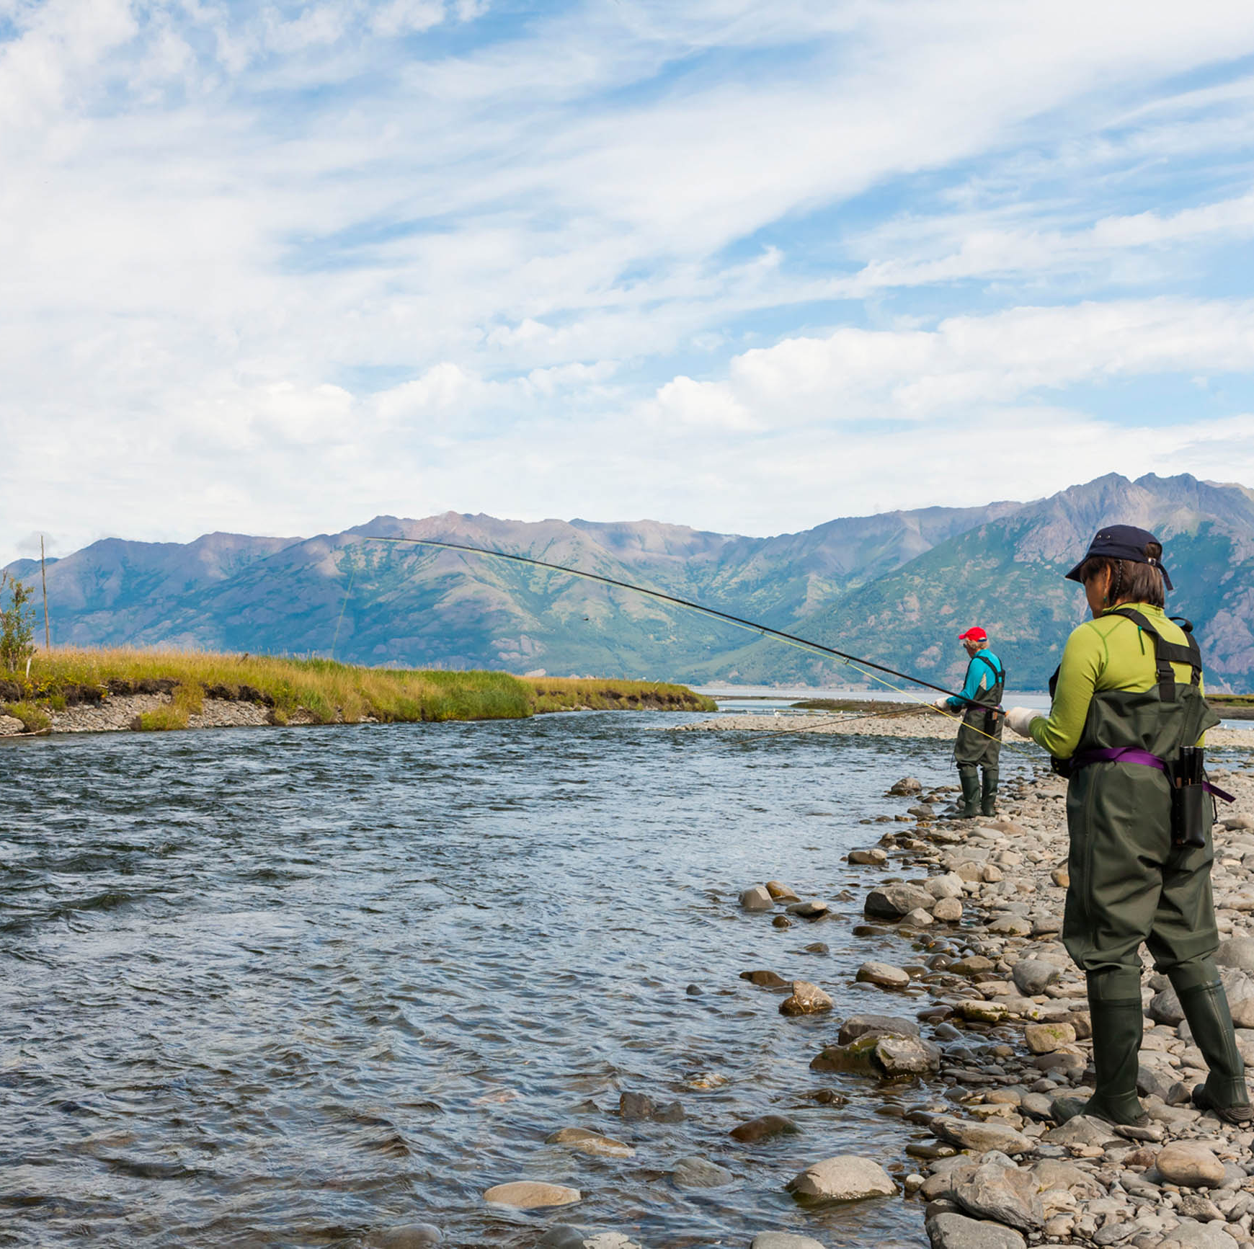
Improved prediction of salmon runs using historical salmon and weather data to enhance business planning and resource allocation
Group Project Proposal
MGT 6203 Spring 2023 - Team 55

Slide 2

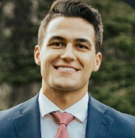




Team Information
Hayden Blackburn
Richard Li
Binh Vu
Lijia Cheng
Alexandra Prokhorova
2 years of experience as data quality engineer
BS Finance/Marketing
BS Industrial and System Engineering
5 years of experience working in semi conductor manufacturing and currently working for a data science interviewing startup
BS Mechanical Engineering/Computer Science
2 years of experience working in aerospace manufacturing industry
BBA (Accountancy)
8 years of public accounting experience
BA Linguistics and BS Electrical Engineering
Risk analyst in a tech consulting company

Slide 3

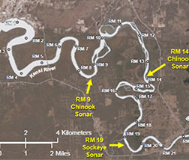
Background Information
Salmon fishing is one of the most valuable industries in Alaska and is a cornerstone of the state's economy. Recreational salmon fishing in the Upper Cook Inlet, which is the Kenai River system, generates 3,400 average annual jobs producing $104 million (2006 dollars) in income (Horton). High variability in fish counts can lead to days of disappointed anglers and inefficient business operations. Creating an accurate fish prediction model would provide invaluable insights for local businesses and anglers.
Our goal is to see if we can create an accurate prediction model using historical fish count data and weather data from the Kenai River.
We expect predictions of fish count to be a useful proxy for the expected demand for goods and services related to the Alaska fishing industry on a given day, which in turn allows local businesses to make better operating decisions to match supply with demand.

Slide 4
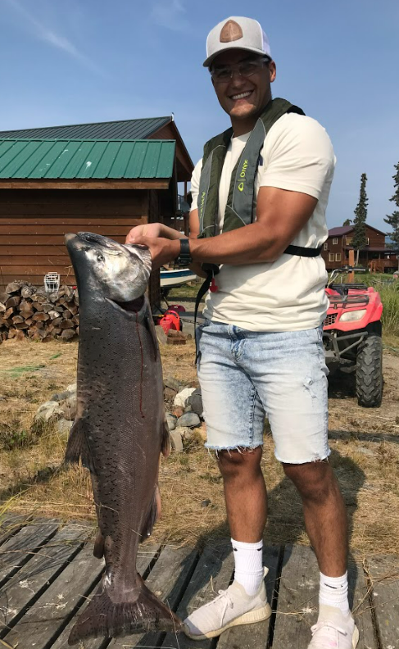
Primary Research Question:
Using the data our team has collected, can we create an accurate fish count prediction model?
Supporting Research Questions:
Will a model providing a daily run count prediction or total season count prediction be more accurate?
Can we use change detection analysis to forecast an incoming large salmon run?
Can we use change detection model to analyze historical salmon run to help local businesses improve resource allocation?
What is the variable that has the most significant impact on sockeye salmon count?
Can a model be created to predict the number of salmon that will run on a given day?

Slide 5


Business Justification
Understanding Alaska's salmon fishery is critical to the success of both the commercial fishing and tourism industries. Predicting fish count and insight into the key factors that influence salmon populations can allow businesses, tourists, and the local government to make more informed business decisions:
Local businesses – Fishing stores, tourism, and hospitality services could benefit from accurate salmon predictions to manage supply and meet anticipated demand.
Alaska Fish and Game (city/government) - Publicize relevant data to locals and visitors. This effort could also be used to manage the fishery, prevent overfishing, and maintain sustainable fish populations
Visitors – Help visitors plan their trip to Alaska based on probabilities for fish run on a given day. Setting realistic expectations is the key to an enjoyable experience and increases the odds of returning to Alaska in the future.

Slide 6
Dataset
Date | Fish count | Precipitation (in) | Air Temperature (degF) | Stage | discharge (ft3/s) | water temp (F) | lunar
7/1/2022 | 5034 | 0 | 57.5 | 9.92 | 15000 | 59.72 | 3
7/2/2022 | 4212 | 0 | 56.5 | 10.02 | 15200 | 59 | 4
7/3/2022 | 5796 | 0 | 58.5 | 10.04 | 15300 | 57.2 | 5
7/4/2022 | 7314 | 0 | 57.5 | 10.08 | 15300 | 56.84 | 6
There are six different datasets that will be used containing data on fish counts, precipitation, temperature, water, and moon phases (proxy for tide data)

Slide 7

Planned Approach
Our approach will be to use a combination of R and Python to do the following:
Six different datasets will be cleaned and joined
Plot and inspect the datasets to detect any potential issues such as correlations, multi-collinearity, and outliers. For highly correlated variables, we will perform a feature selection process to retain only the most relevant variables
Split data into training, validation, and test datasets
Data preparation
Data exploration
Model training
Use cross-validation as a resampling technique and stepwise regression for variable selection/hyperparameter optimization. All regression models will be compared to a baseline R-squared/adjusted R-squared value (linear regression)
Model optimization
Converting any unit mismatches (Celsius to Fahrenheit)
Investigate the trends in salmon runs over time and identify any seasonal patterns or irregularities
If the Q-Q plot and residuals vs fitted plot show non-linearity patterns, we will use log transformations
Fit several types of ML models such as linear regression, logistic regression, k-means clustering, and CUSUM. Each of these models will give us different insights into the dataset such as identifying important variables and detecting trends in the data

Slide 8
Why does it matter?
Anticipated Conclusions
Benefits of the analysis
Through our modelling efforts – our change detection model will be the most accurate model because it will use the historical fish count data from Alaska Fish and Game which utilizes sonar technology to count the incoming fish. With these insights and the data to back up the conclusions, we can describe characteristics of good/bad fishing days to local businesses, and they can use that data to appropriately plan staffing and inventory levels. Tourists would also be able to plan their fishing trips based on the variables that we find significant which will improve their satisfaction and increase the likelihood of them returning to Alaska to sustain the tourism economy.
The fishing industry is one of the key drivers of tourism and business in Alaska. The ability to forecast the incoming fish population will allow the authorities to better regulate the fish population and help maintain ecological balance. Local businesses, such as hotels, restaurants, and local fishermen, can calibrate their business needs in accordance with the fish population forecast. In general, Alaska as a state could better allocate funding and resources based on our model prediction.

Slide 9

PROJECT TIMELINE
11 Mar
Data cleaning and joining datasets
18 Mar
Data exploration and visuals
25 Mar
Model training and optimization, Record project plan video presentation
1 Apr
Project progress report
8 Apr
Project report and slides
15 Apr
Record final video presentation

Slide 10

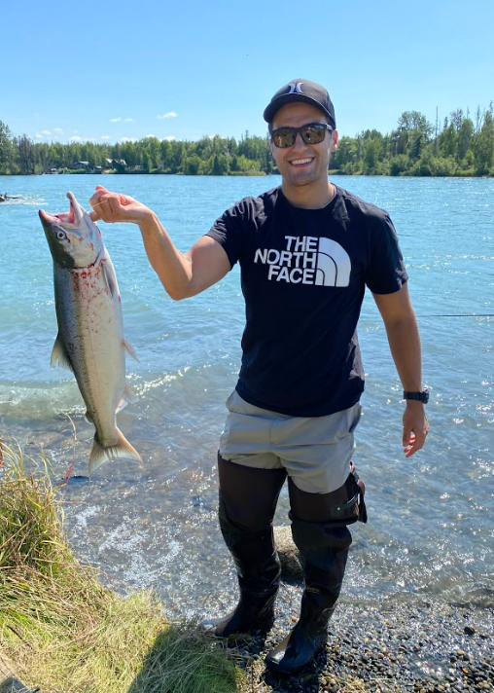
Thank you

Slide 11
Appendix

Slide 12
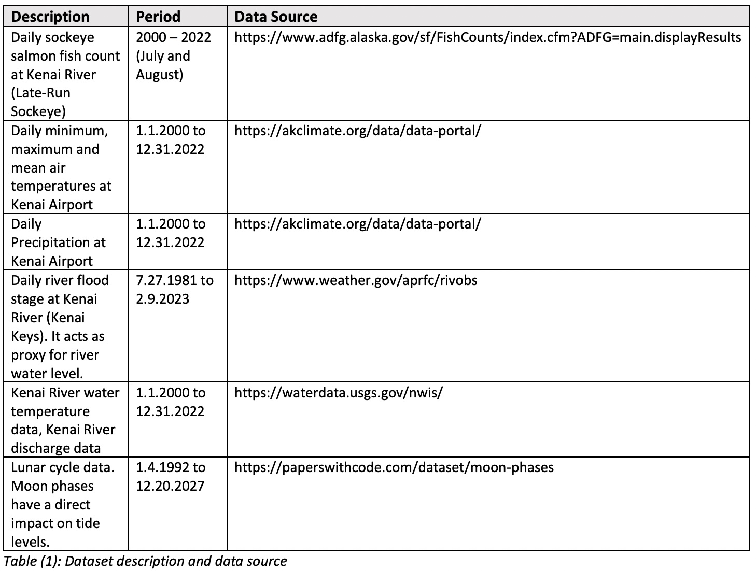
Data description and sources

Slide 13
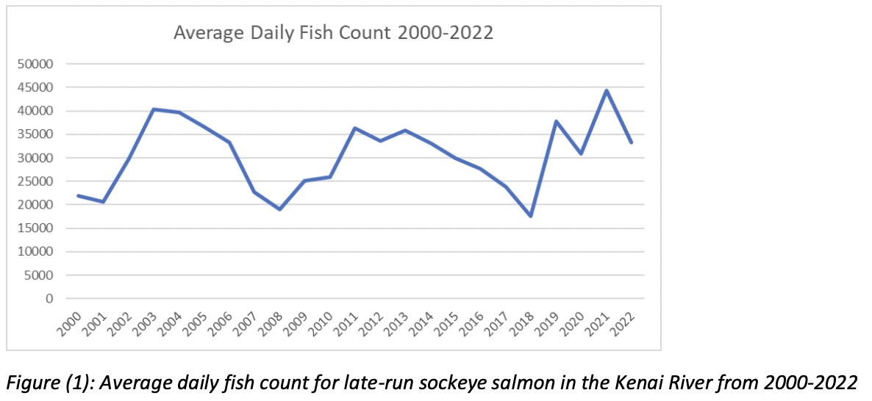
Illustrative graph plot of late-run sockeye salmon

Slide 14
Citations
Horton, C. (2016, December 5). Economic impact of fishing the Kenai Peninsula up for debate. Alaska Journal. Retrieved March 12, 2023, from https://www.alaskajournal.com/community/2008-05-25/economic-impact-fishing-kenaipeninsula-debate
Alaska Climate Research Center. (n.d.). Retrieved March 12, 2023, from https://akclimate.org/data/data-portal/
Hedstrom. (n.d.). Fish count data search. Fish Counts - Sport Fish - ADF&G. Retrieved March 12, 2023, from https://www.adfg.alaska.gov/sf/FishCounts/index.cfm?ADFG=main.displayResults
Mateos, L. (n.d.). Moon phases dataset. Moon Phases Dataset | Papers With Code. Retrieved March 12, 2023, from https://paperswithcode.com/dataset/moon-phases
US Department of Commerce, N. O. A. A. (2020, September 23). Historical river observations database. National Weather Service. Retrieved March 12, 2023, from https://www.weather.gov/aprfc/rivobs USGS water data.
USGS water data for the nation. (n.d.). Retrieved March 12, 2023, from https://waterdata.usgs.gov/nwis/
Alaska Department of Fish and Game. (2000-2022). Upper Cook Inlet Commercial Fisheries Annual Management Report. Retrieved from https://www.adfg.alaska.gov/index.cfm?adfg=commercialbyareauci.salmon#management

Slide 15
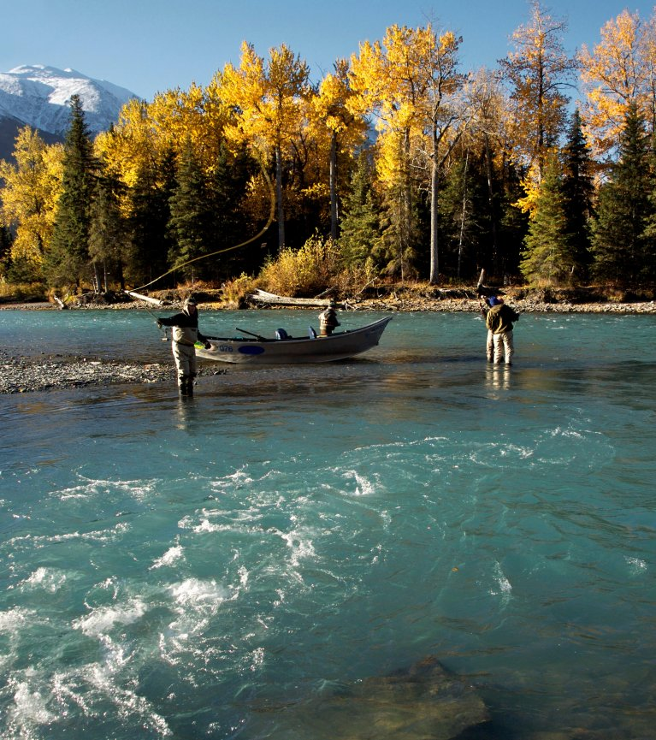
Plan for data
Dependent
Daily number of sockeye salmon
Independent
Air temperature
Potential new indicator variables
Water temperature
River flood level in stages
Precipitation
River discharge
Moon phase
MoonStage: an interaction term between moon phase and flood stage for insight into tide data
Large run: 0 when run is small, 1 when run is large (cutoff size to be determined)
River discharge: Low, medium, high categories
Moon phase: new moon, first quarter, full moon, third quarter, and
*Net Data

